Slide 1
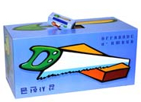
“ALABASTER” CELEBRATING “75” YEARS
THE NMI COUNCIL AND I CHALLENGE
EACH FAMILY TO GIVE $75+ IN THE ALABASTER OFFERING IN FEBRUARY

