Slide 1
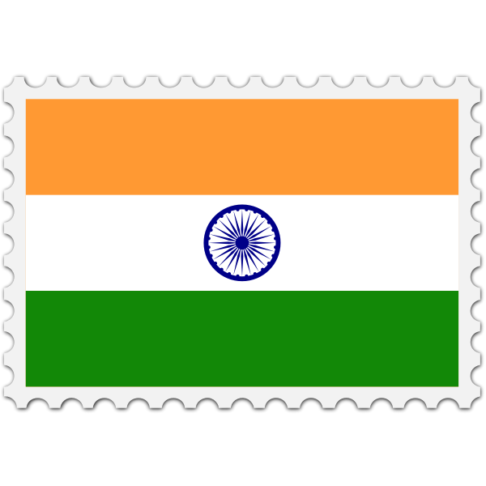
India-Missionary Lesson
1-14-24

Slide 2
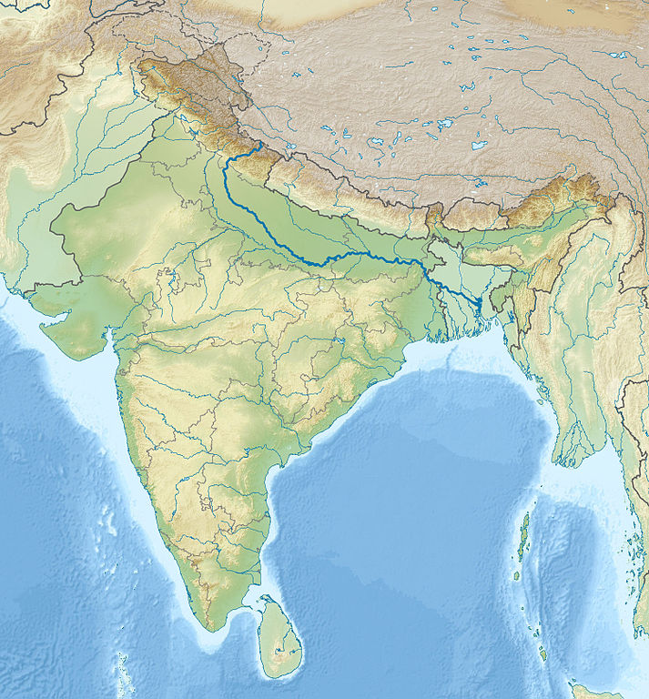
Geography
Subcontinent
Mountains
Rivers
Alluvial Plain
Delta

Slide 3
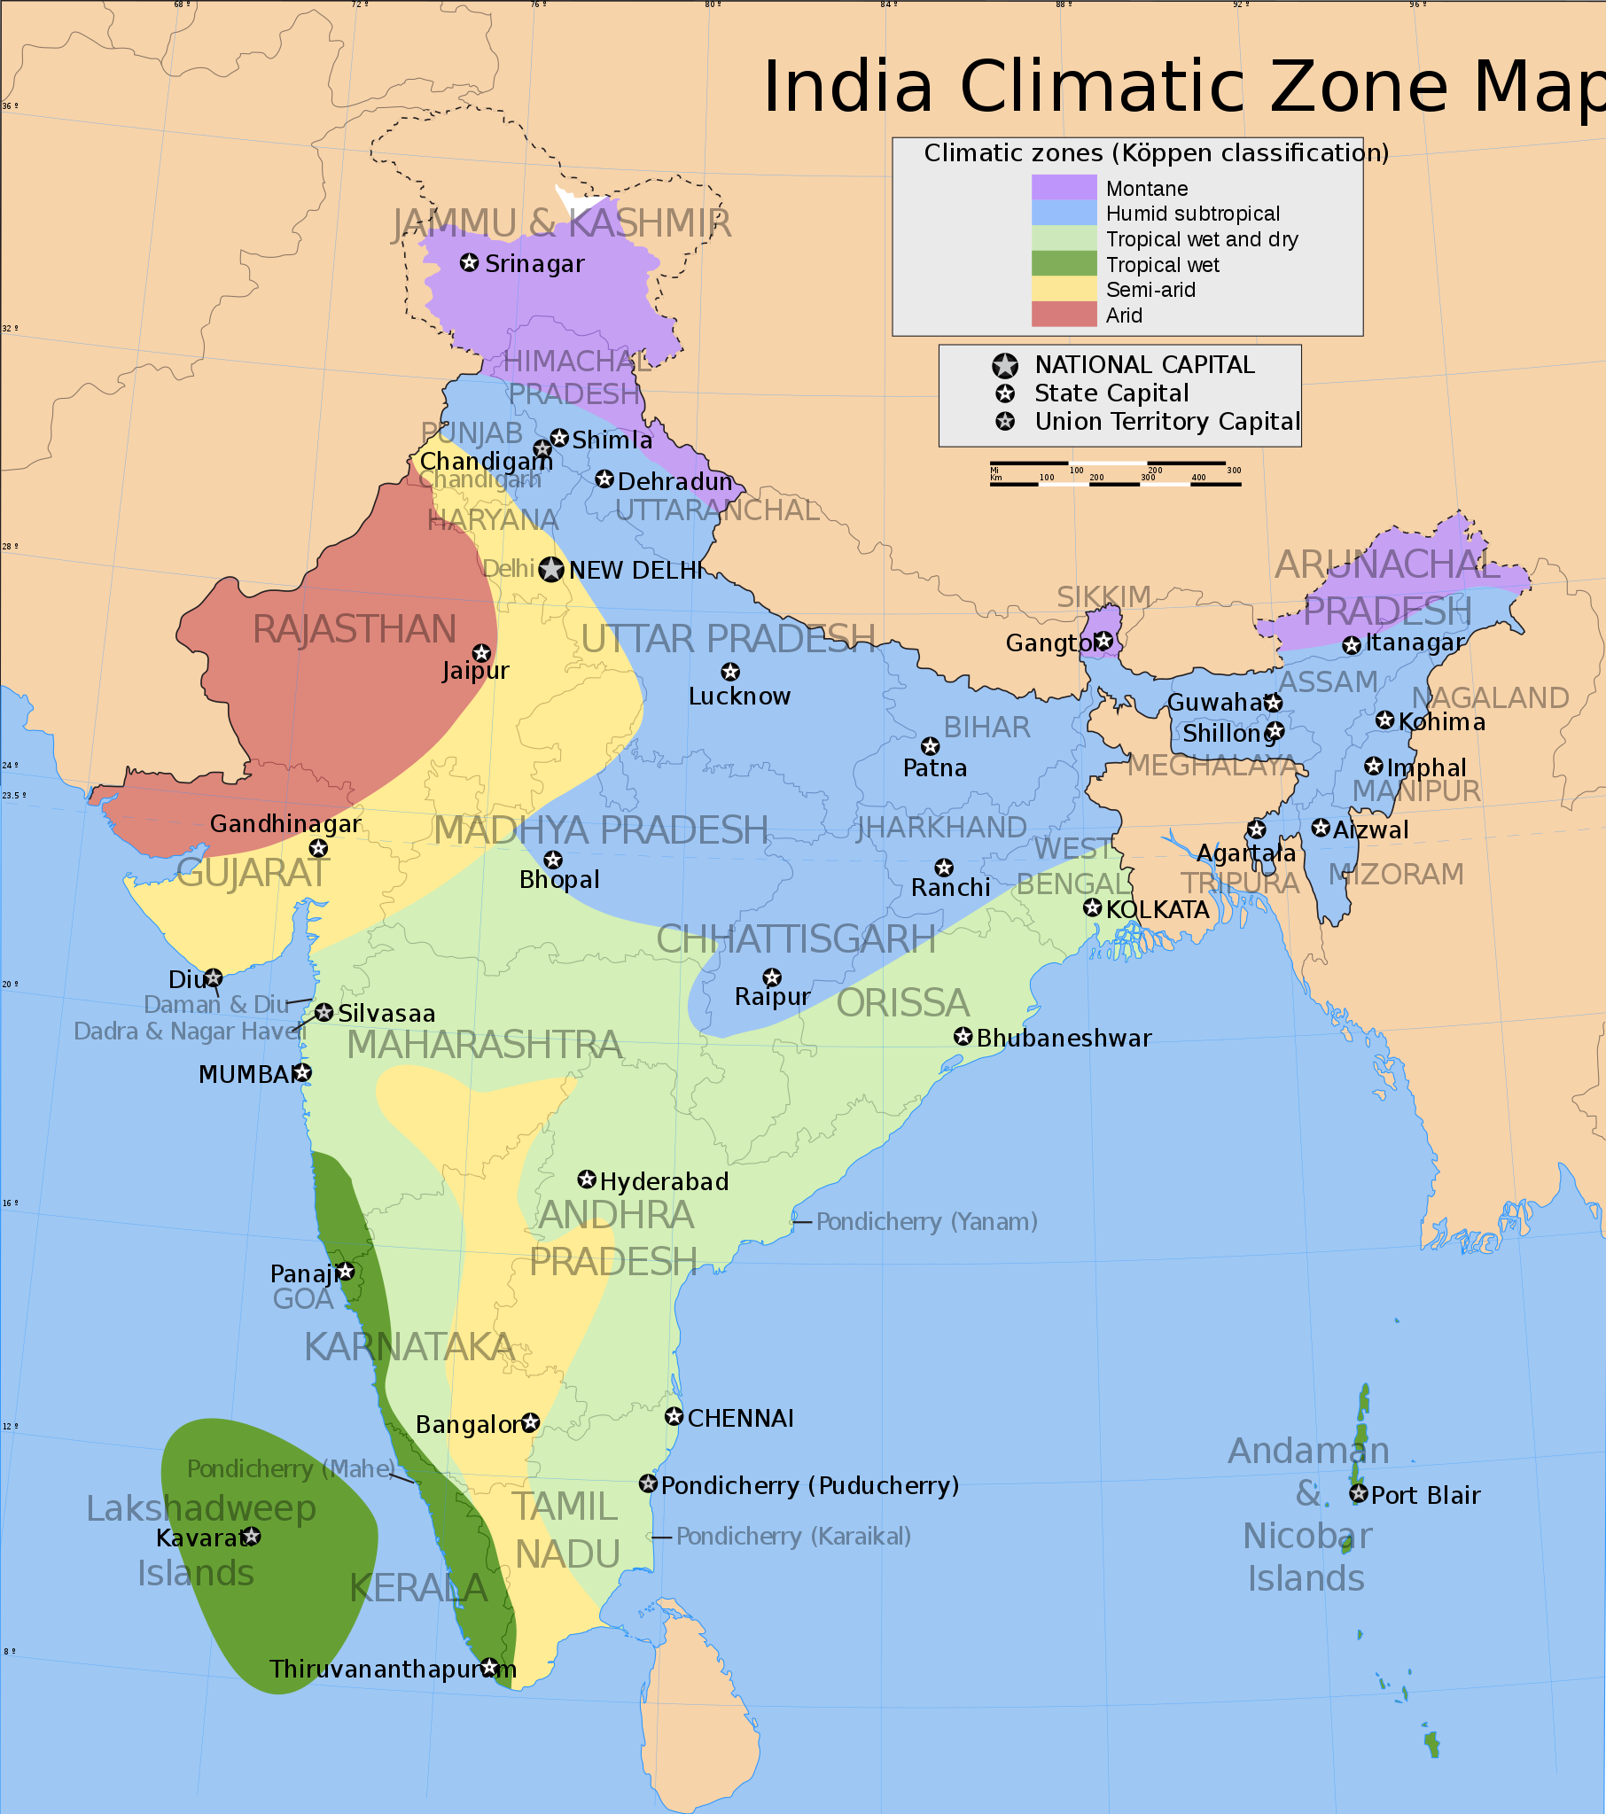
Climate
Monsoons
Cyclones
Wet/Dry Climate

Slide 4
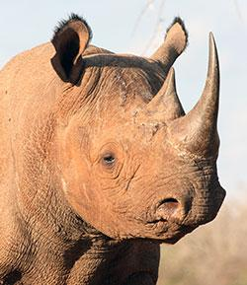
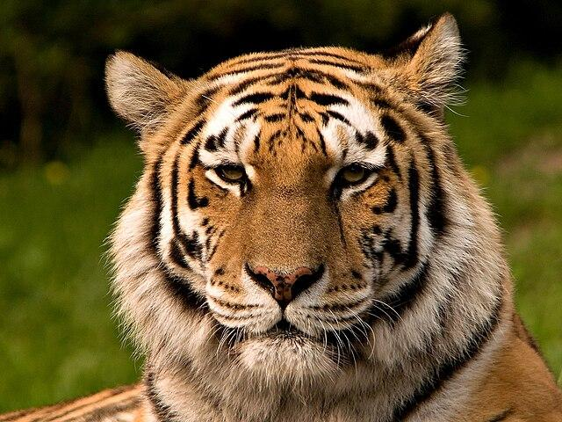
Natural Resources
Largest Country in Southeast Asia
Most productive land, water and mineral resources
Rivers are very important and sacred
Mica
Forests and endangered animals

Slide 5
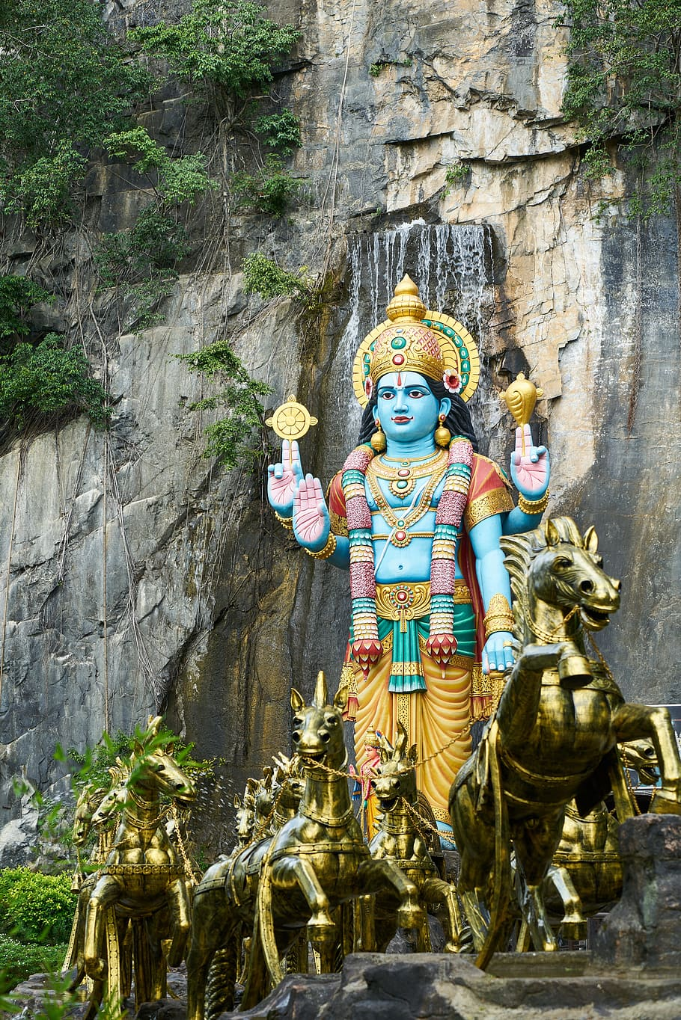
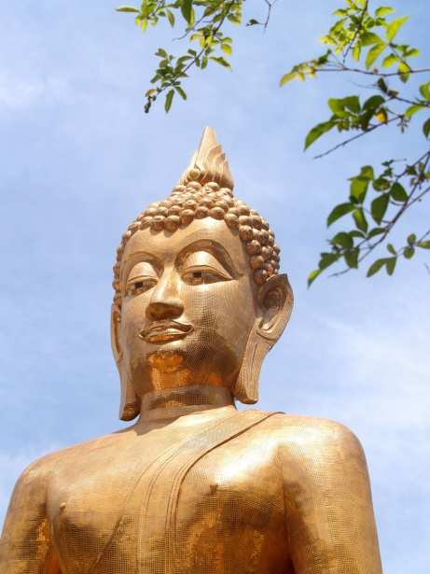
Religion
Hinduism-one universal God, souls, and karma.
Jainism-always speak the truth, do not steal, show sexual restraint
(with celibacy as an ideal), and do not become attached to worldly things
Buddhism
Islam-1500s and 1600s

Slide 6
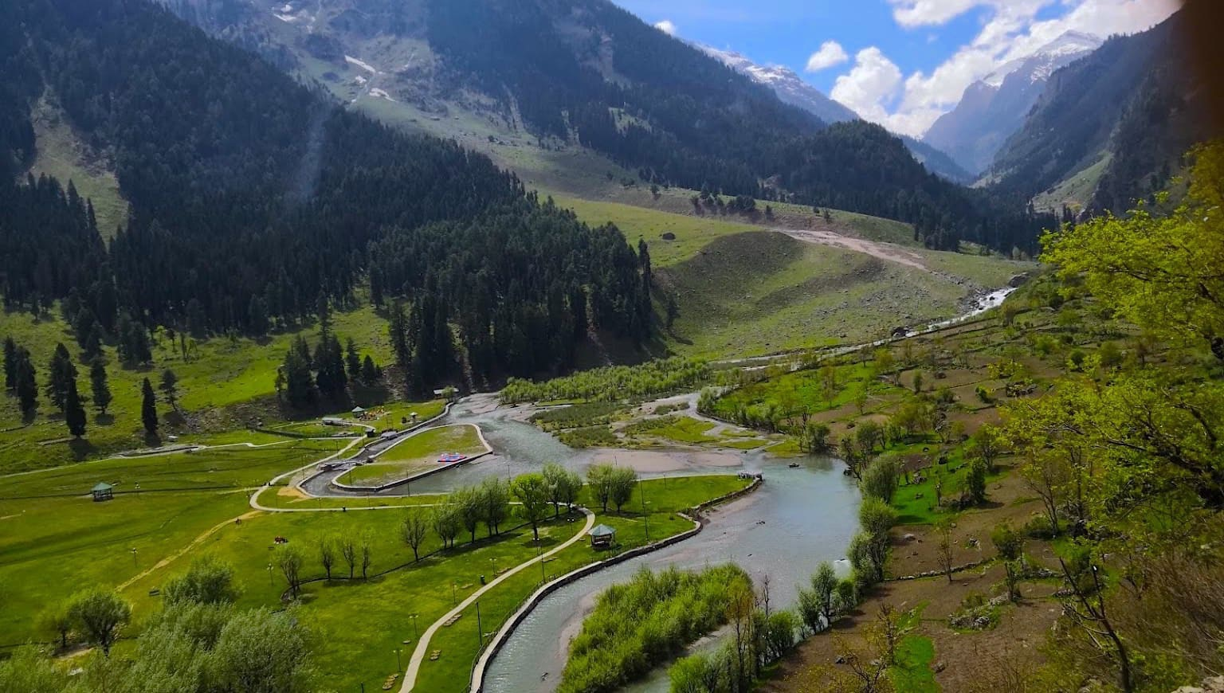
History
1500s-After the Mughal Empire declined, Great Britain took control of India.
1947 Independence gained.
Struggle between Muslims and Hindus has caused multiple wars and continuing division. Kashmir

Slide 7
Population
1.22 Billion
World’s second most populous country.
Average age of India is 25.
Generational-many extended families live together.

Slide 8
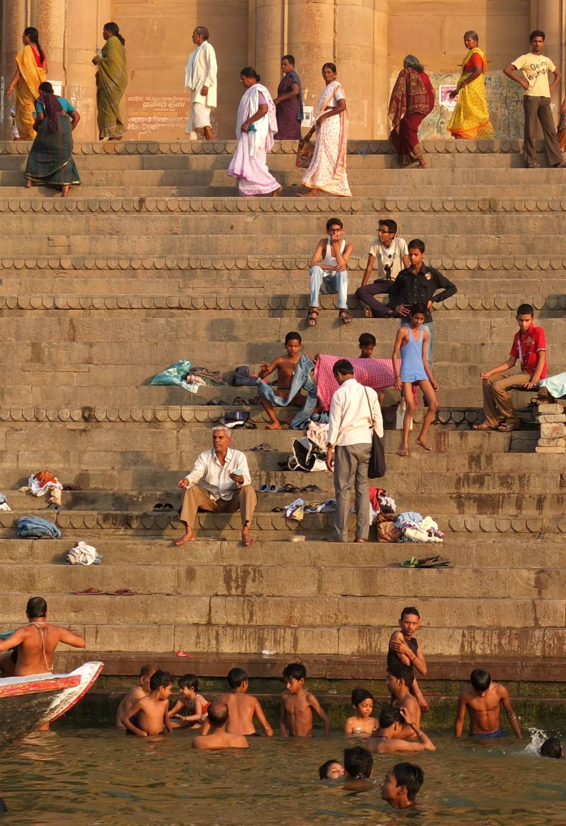
Challenges
Growing enough food for all those people.
Caste System and Untouchables
Pollution
For Hindus, it’s the Mother Goddess Ganga herself and a focus of religious
devotion for tens of millions of people across the world. It’s also a vital source
of water and life for more than 40 per cent of India’s billion-plus population.
Deforestation

Slide 9
The Nazarene Church in India since 1898
Christianity is a small minority; however, the work of the Church of the Nazarene is noted for its ministries in compassion, child development, education, and local churches lovingly serving their communities in holy ways.
130,258 Members
1943 Fully Organized Churches
548 Not Yet Organized Churches
395 District Licensed
216 Ordained Ministers on 15 Districts

Slide 10
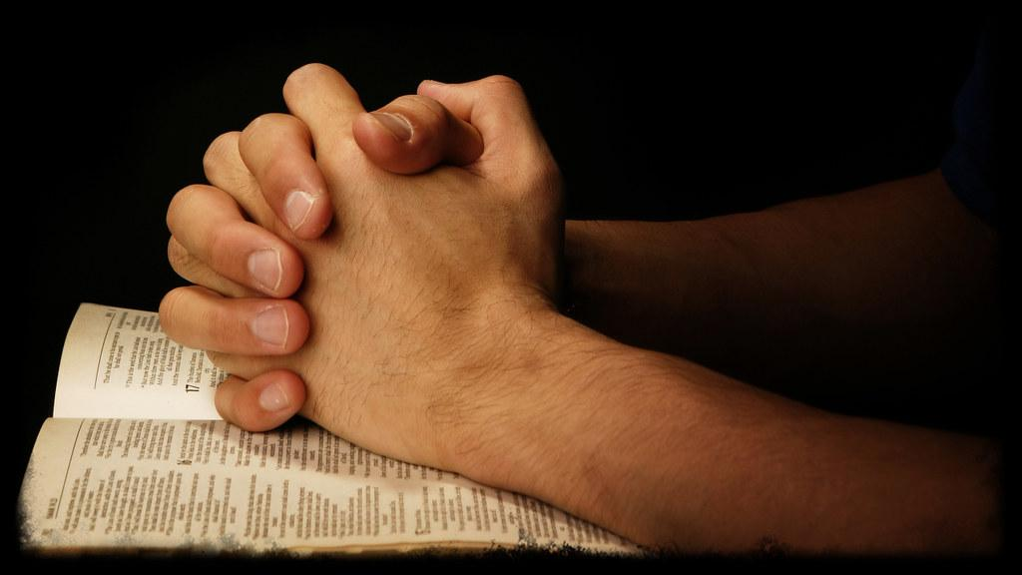
God is moving in India!
https://www.youtube.com/watch?v=dA0BI14y9eg

