Slide 1
JAPAN
April 2, 2022

Slide 2
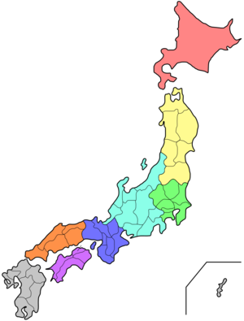
Geography
Archipelago
Islands
Mountains
Sea of Japan

Slide 3
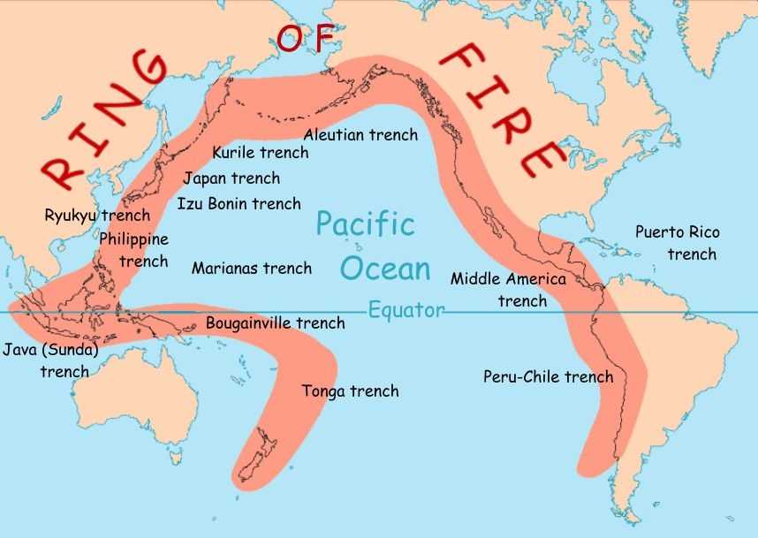
Ring of Fire
Earthquakes
Volcanoes
This Photo by Unknown Author is licensed under CC BY-NC

Slide 4
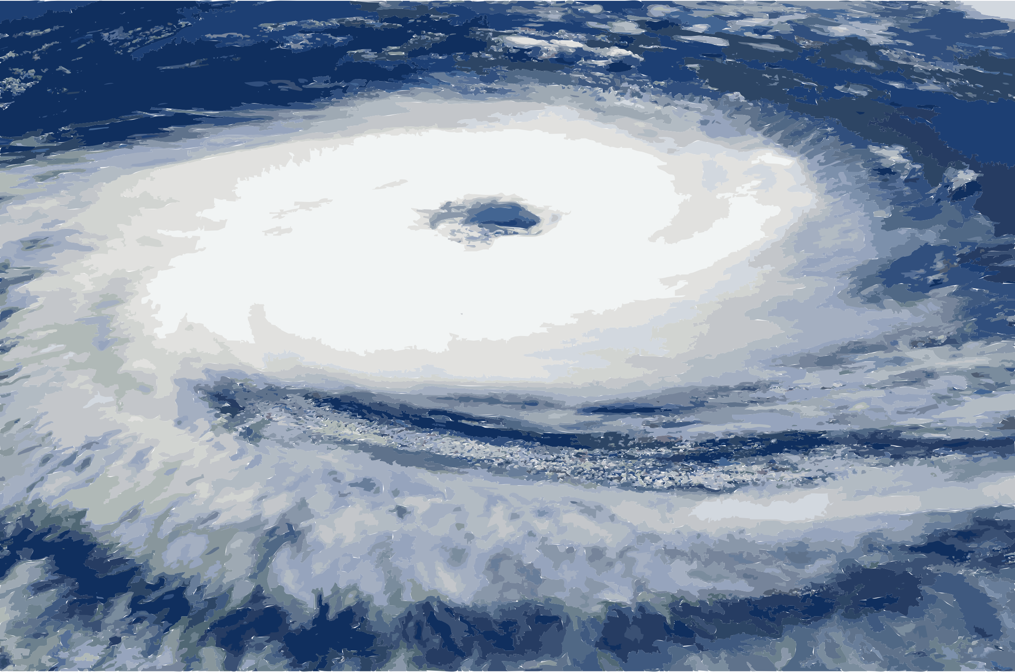
NATURAL DISASTERS CONTINUED
Typhoons

Slide 5
Farming
Only 12 % of the land is used for cultivation
Terrace farming
Rice is the most important crop
Most farms are on a small scale, not like the US with large farming operations
Aging farmers are a problem for Japan because no one wants to farm

Slide 6
CLIMATE-SIMILAR TO OURS DUE TO L/L OF JAPAN

Slide 7
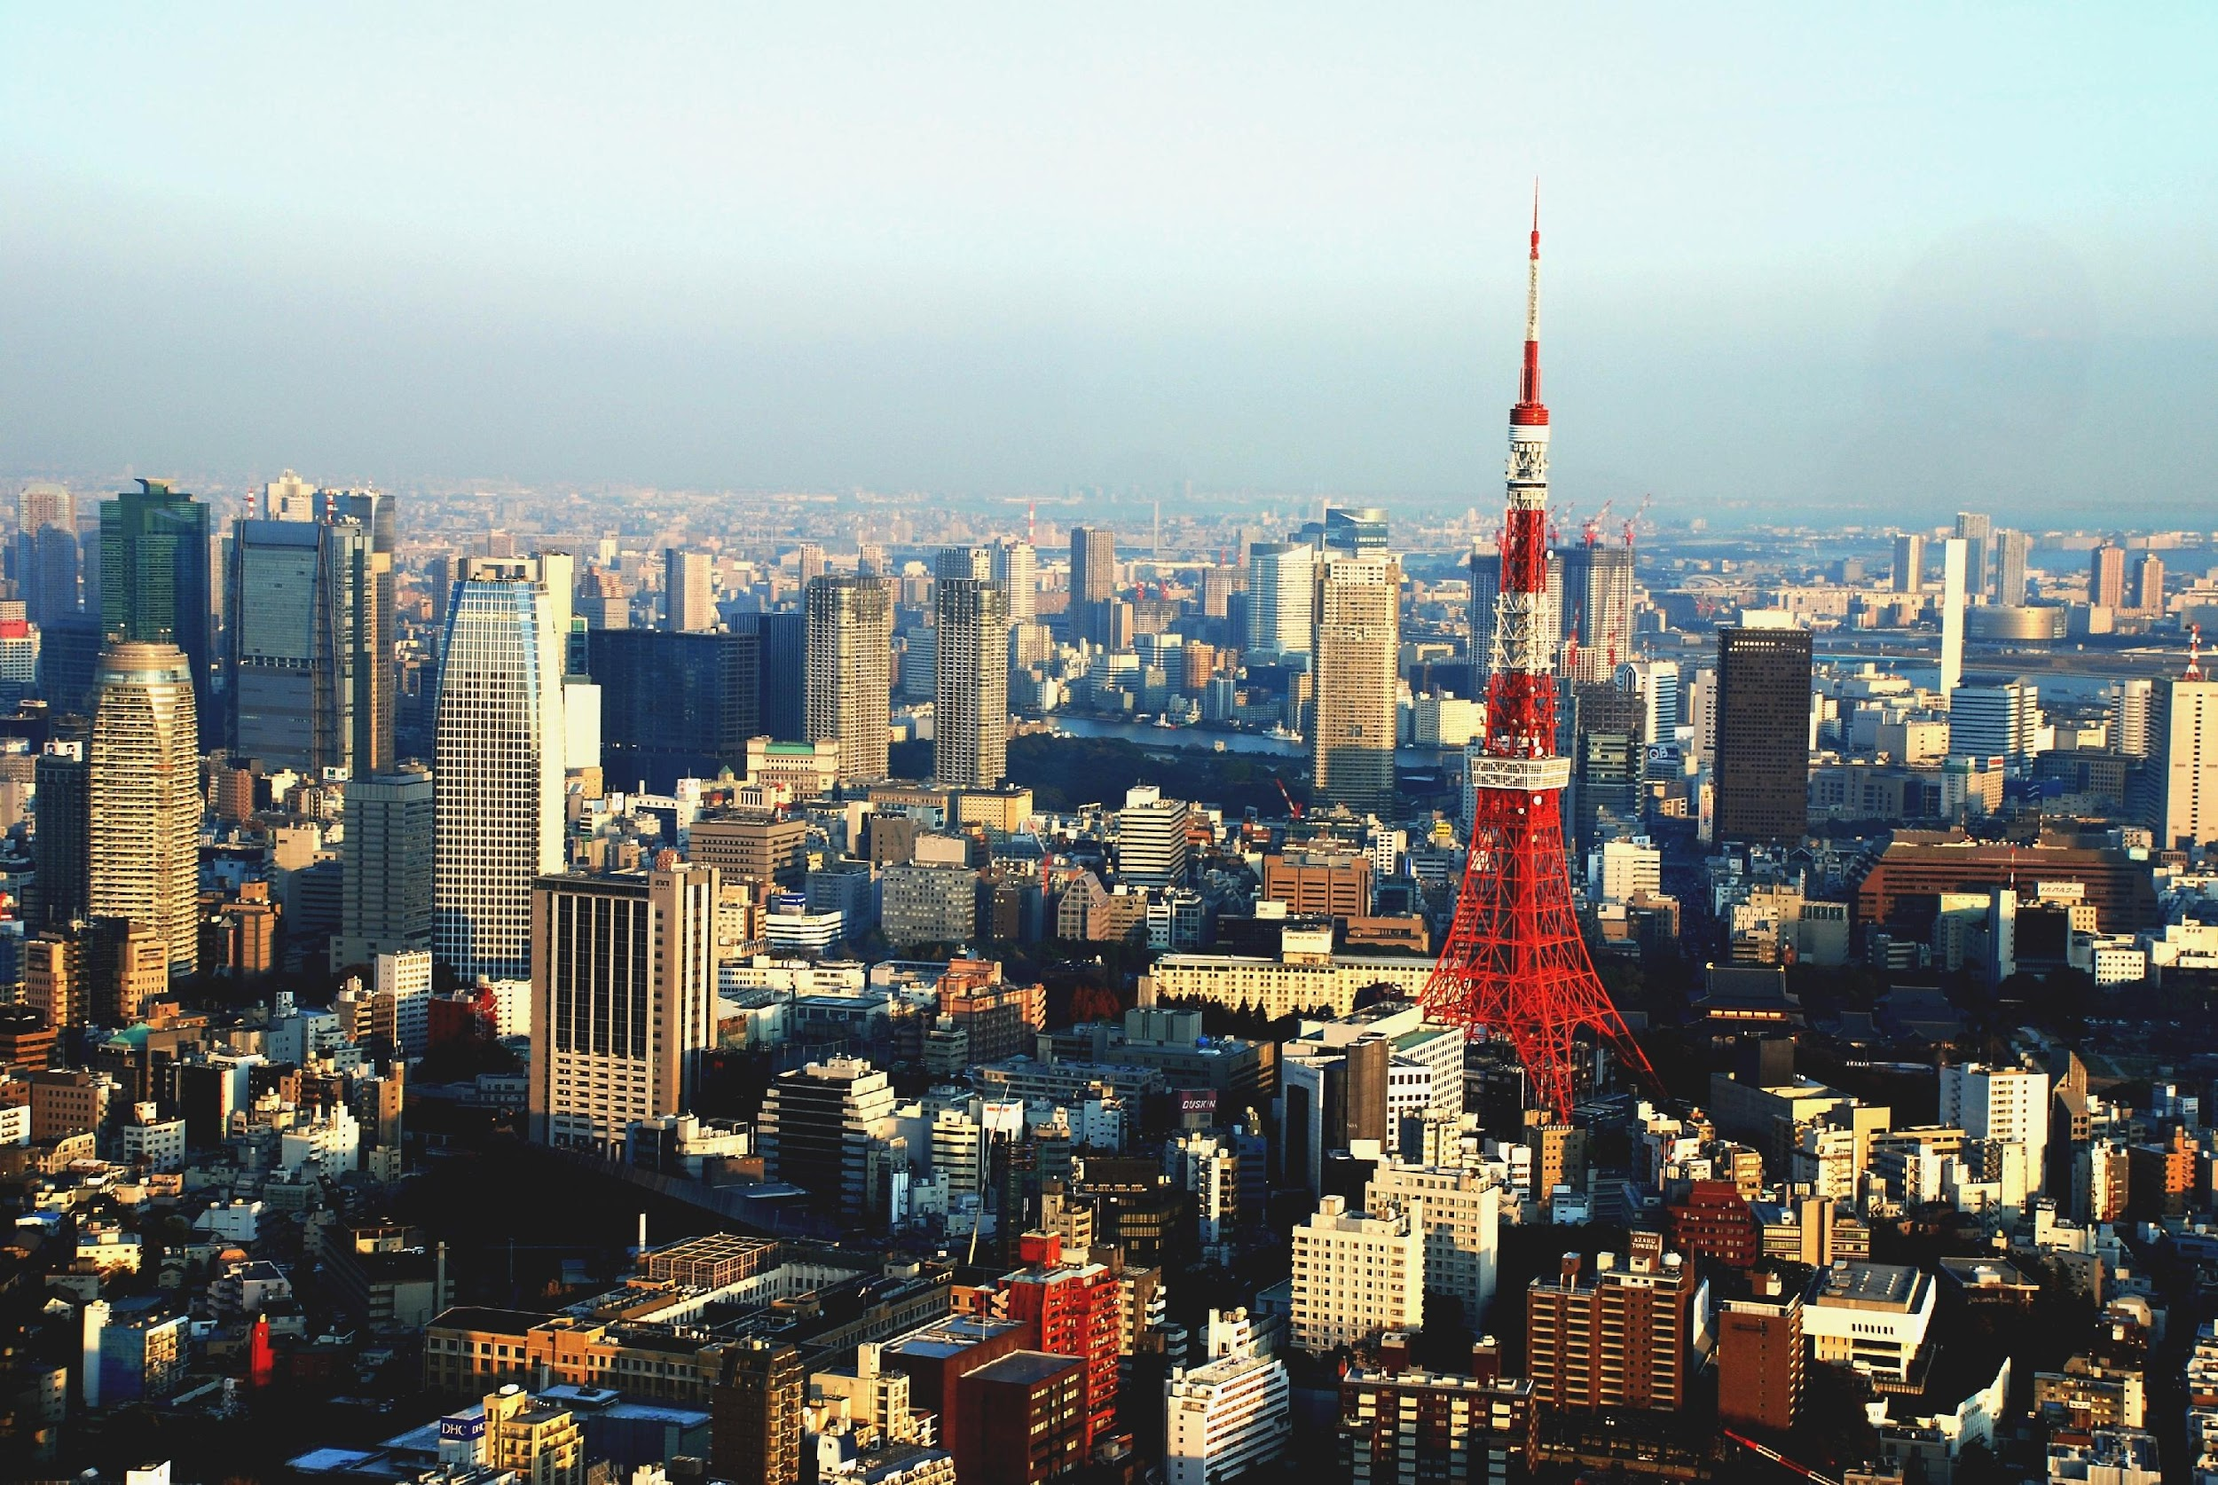
Tokyo
Largest city
Population
9.3 Million

Slide 8
CONSTITUTIONAL MONARCHY EMPEROR WITH TITLE BUT LITTLE POWER VERY LARGE ARMY
This Photo by Unknown Author is licensed under CC BY-SA

Slide 9
3rd Largest Economy in the World
Exports: electronics, tools, ships, chemical substances, and textiles
Imports: manufacturing equipment, fossil fuels, foods (beef), and raw materials
Major companies: Toyota, Honda, Canon, Nissan, Sony, Mitsubishi, Panasonic, Lexus, Subaru, Nintendo. Etc.….

Slide 10
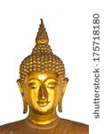
Religion
Buddhism (major)
Shinto (major)
Christianity (minor)

Slide 11
The Church of the Nazarene
There are 70 churches in Japan!
https://nazach.exblog.jp/
www.Nazarene.or.jp/
http://naz100.exblog.jp/

