Slide 1
North Africa
Missionary Lesson

Slide 2
North Africa
Missionary Lesson

Slide 3
Matthew 28: 19-20
Therefore go and make disciples of all nations, baptizing them in the name of the Father and of the Son and of the Holy Spirit, and teaching them to obey everything I have commanded you. And surely I am with you always, to the very end of the age.”

Slide 4
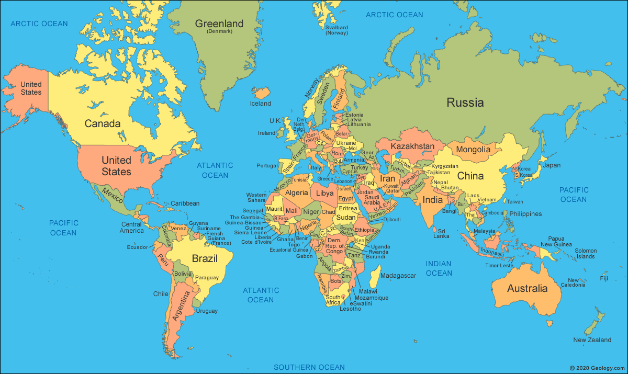

Slide 5
North Africa

Slide 6
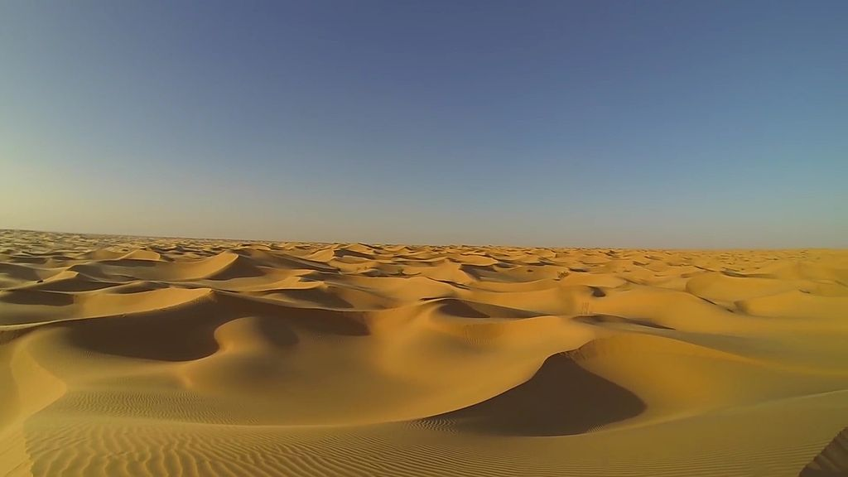
Sahara Desert

Slide 7
Water--How important is it?

Slide 8
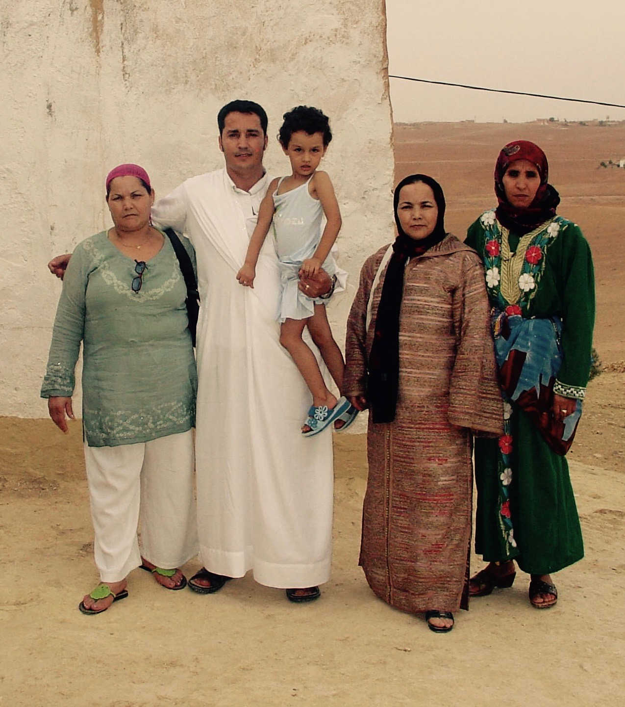
People of North Africa
What do you know?
Facts

Slide 9
Genesis 2
And there was evening, and there was morning--the fifth day. And God said, "Let the land produce living creatures according to their kinds: livestock, creatures that move along the ground, and wild animals, each according to its kind." And it was so.
He brought them to the man to see what he would name them; and whatever the man called each living creature, that was its name. So the man gave names to all the livestock, the birds of the air and all the beasts of the field.

Slide 10
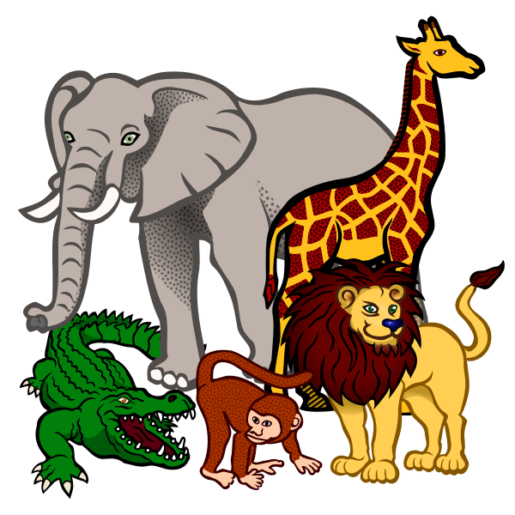
Animals of North Africa
https://www.youtube.com/watch?v=KgSXOUkf2wU

Slide 11
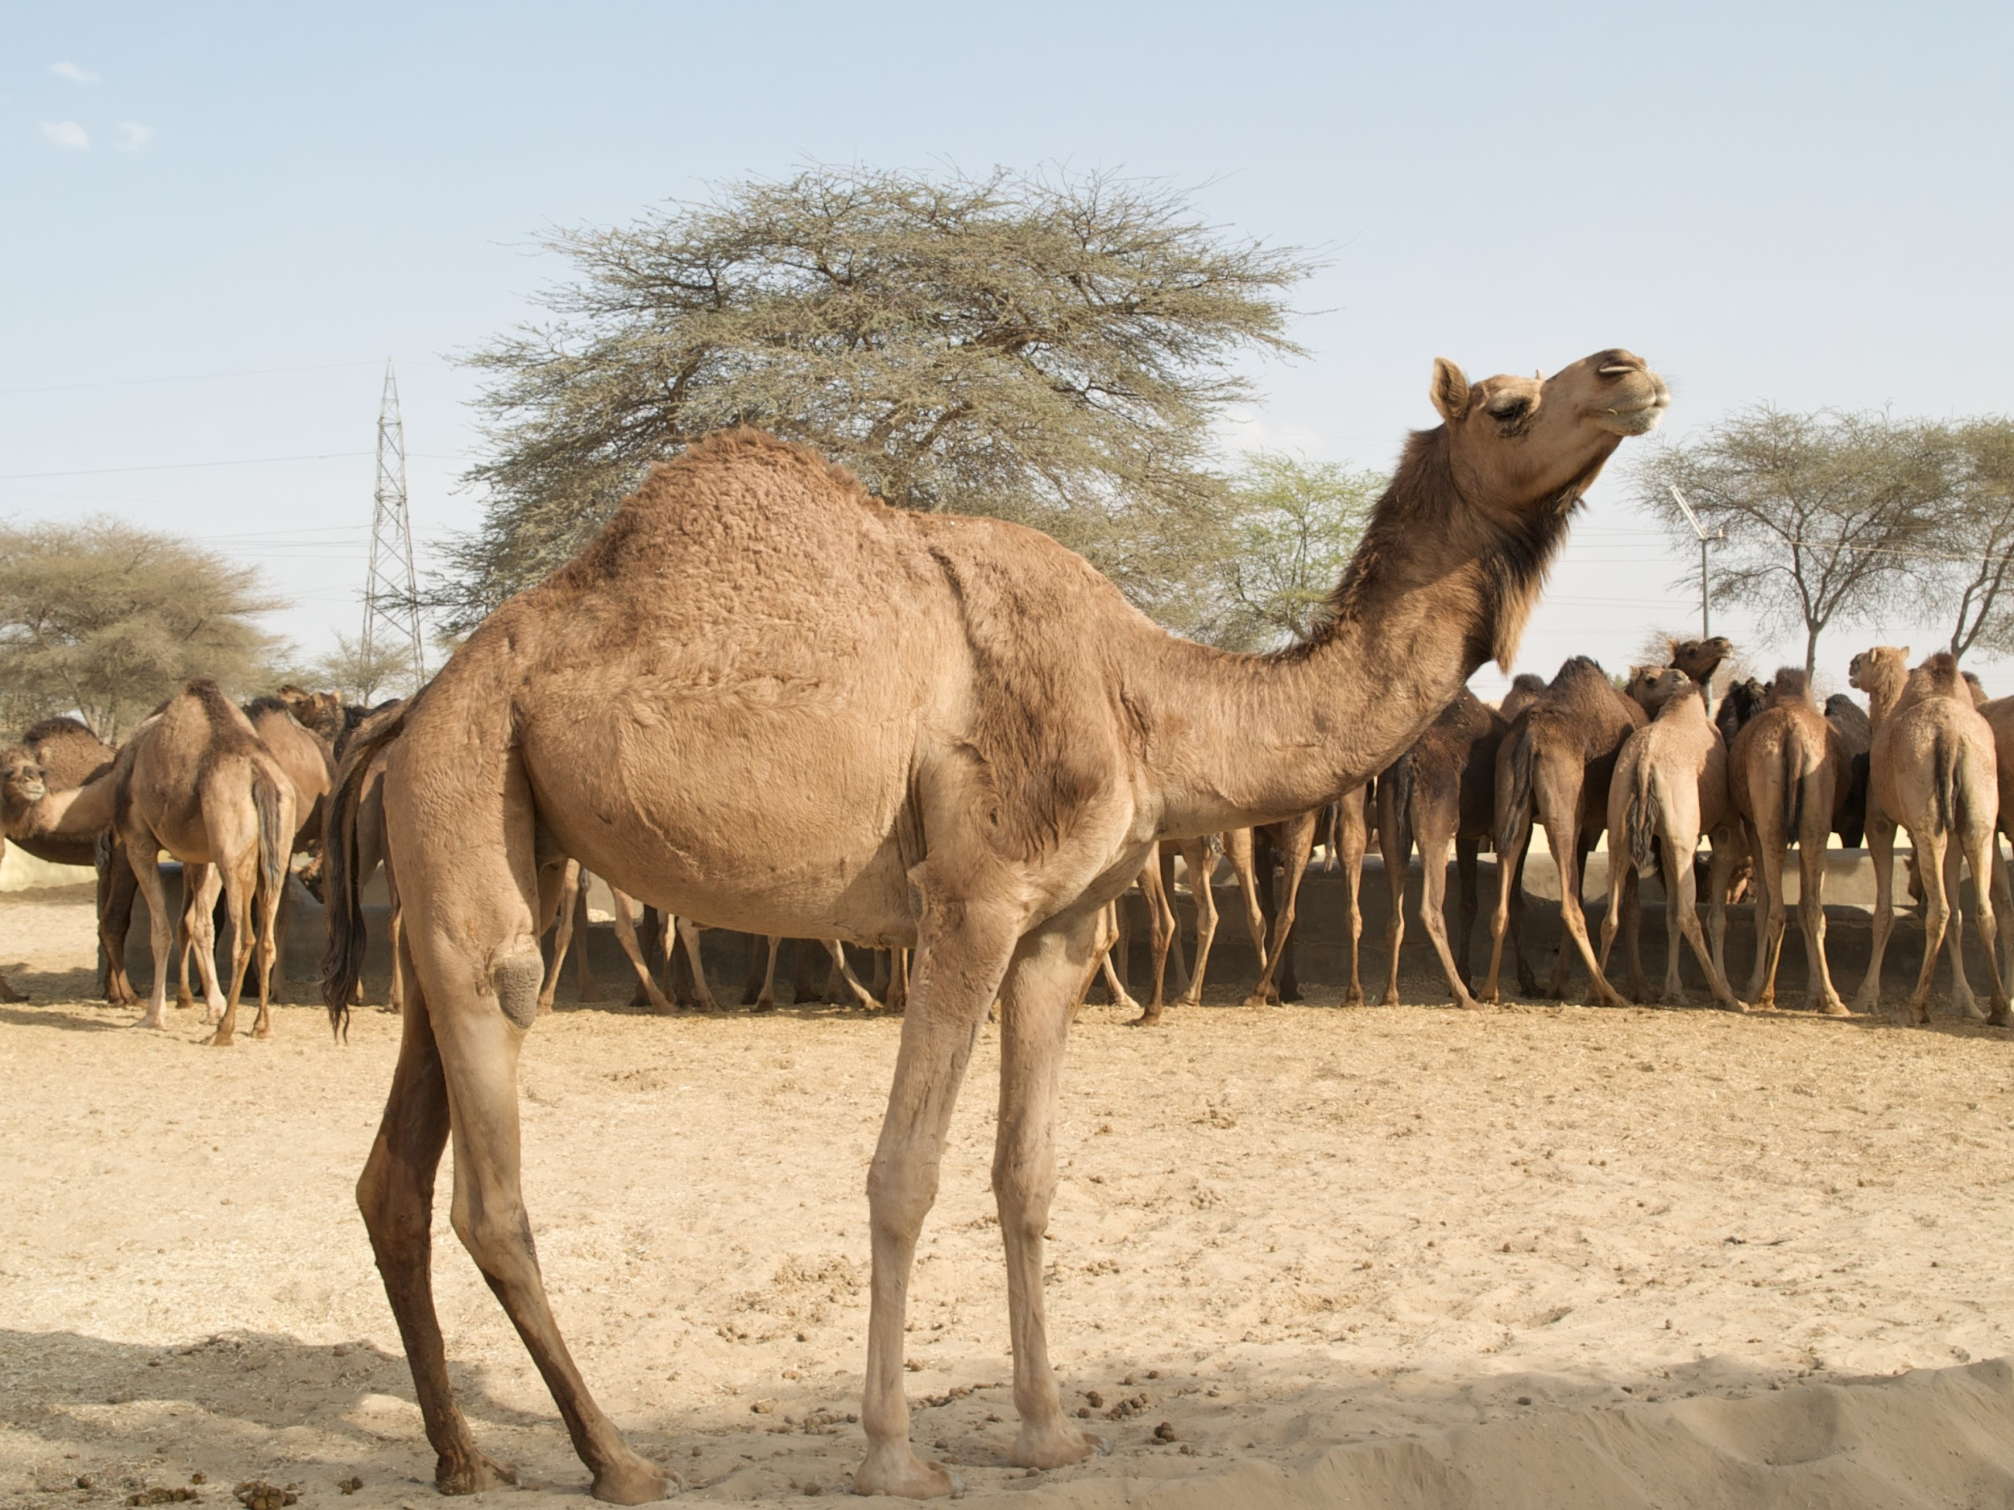
Camels
What do you know.
Types
Facts

Slide 12
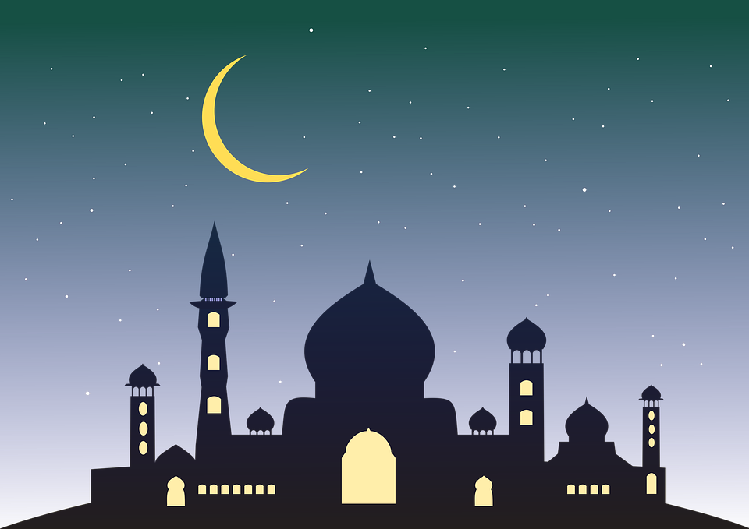
Our Missionaries
Serving through Creative Access in many countries
in North Africa.
North Africa has a large population of Muslims.
Some countries are under Islamic law.
Pray for our missionaries in North Africa.

Slide 13
Matthew 28: 19-20
Therefore go and make disciples of all nations, baptizing them in the name of the Father and of the Son and of the Holy Spirit, and teaching them to obey everything I have commanded you. And surely I am with you always, to the very end of the age.”

Slide 15
North Africa

Slide 16
Sahara Desert

Slide 17
Water--How important is it?

Slide 18
People of North Africa
What do you know?
Facts

Slide 19
Genesis 2
And there was evening, and there was morning--the fifth day. And God said, "Let the land produce living creatures according to their kinds: livestock, creatures that move along the ground, and wild animals, each according to its kind." And it was so.
He brought them to the man to see what he would name them; and whatever the man called each living creature, that was its name. So the man gave names to all the livestock, the birds of the air and all the beasts of the field.

Slide 20
Animals of North Africa
https://www.youtube.com/watch?v=KgSXOUkf2wU

Slide 21
Camels
What do you know.
Types
Facts

Slide 22
Our Missionaries
Serving through Creative Access in many countries
in North Africa.
North Africa has a large population of Muslims.
Some countries are under Islamic law.
Pray for our missionaries in North Africa.

